Slide 1
Exceptions

Slide 2
What is an exception ?
class DivideByZero{
public static void main(String str[])
{
int z= 45/0;
}}
Runtime error
Exception in thread "main" java.lang.ArithmeticException: / by zero at DivideByZero.main(DivideByZero.java:5)

Slide 3
An exception is an abnormal condition that arises while running a program.
Examples:
Attempt to divide an integer by zero causes an exception to be thrown at run time.
Attempt to call a method using a reference that is null.
Attempting to open a nonexistent a file for reading.
JVM running out of memory.

Slide 4
Why is exception handling required?
To recover from the error condition.
To give users friendly, relevant messages when something goes wrong.
To conduct certain critical tasks such as “save work” or “close open files/sockets” in case some occurrence forces abnormal termination.
To allow programs to terminate gracefully or operate in degraded mode.

Slide 5
Exception Hierarchy
java.lang.Throwable
Our focus!
java.lang.Exception
java.lang.Error
java.lang.VirtualMachineError
checked
unchecked
When an exception occurs in a method, an object of Throwable type is thrown.
Checked exceptions or compiler-enforced exception
Unchecked exceptions or runtime exception

Slide 6
java.lang.Error
java.lang.Exception
unchecked exception
unchecked exception
java.lang.RuntimeException
java.io.IOException
java.sql.SQLException
java.lang.ArithmeticException
checked exception
java.lang.NullPointerException
many more classes …
many more classes…

Slide 7
Syntax
Exception handling block:
try{
…
}
catch(ExceptionType1 e){ …}
[catch(ExceptionType2 e){ …}]
finally { ... }
Code that may throw exception

Slide 8
Handling exceptions in the code
public class NullException {
static String s;
public static void main(String[] a){
try{ System.out.println(s.length());}
catch(NullPointerException n){
System.out.print("String not initialized");
}}}
This code handles unchecked exception.

Slide 9
Multiple catches
public class NoArgument{
public static void main(String[] args){
try{
int j=10/args.length;
System.out.println(j);
System.out.println(args[1]);
}catch(ArithmeticException e){
System.out.println("command line arguments not entered");
catch(ArrayIndexOutOfBoundsException a){
System.out.println("command line 2nd arguments not entered");
}
}}

Slide 10

exceptions
Execution paths
Path 1: java NoArgument
command line arguments not entered
Path 2: java NoArgument 1
Result:
10
command line 2nd arguments not entered
Path 3: java NoArgument X Y
Result: 5
Y
normal path
In Path 1, why args.length is not throwing NullPointerException ?

Slide 11

Sequencing catches
class DivideByZero {
public static void main(String[] args) {
try{ int i=10/0;}
catch(Exception e){
System.out.println(“general error");}
catch(ArithmeticException e1){
System.out.println(“div by zero ");}
}}
Should be moved to correct compiler error.
Why should I waste my time for something that is never going to be executed ?
compiler

Slide 12
Nesting try blocks
public class MulTry {
public static void main(String[] s) {
try{
try{
String n[]= new String[s.length-1];
System.out.println(n[0]); }
catch(ArrayIndexOutOfBoundsException ae){
System.out.println("Out of bounds");}
}
catch(NegativeArraySizeException ne){
System.out.println("Array size cannot be negative");}
}}
Can you guess what will happen when we execute this code with no arguments?
Notes:
o/p: Array size cannot be negative

Slide 13
All the exceptions we have caught so far are unchecked exceptions. Hence it is not compulsory that we handle them explicitly in our code. Compiler does not complain because if you don’t handle... JVM will handle it.

Slide 14
Exception class
Constructors:
public Exception()
public Exception(String message)
Important methods:
public String getMessage()
public void printStackTrace()

Slide 15
Stack Trace
If an exception is not caught in a method it is passed on and on to the calling methods until some method handles it. If no method handles it, the JVM handles it.
The printStackTrace() prints the trace of this exception propagation.
public class Stacktrace {
public static void main(String[] s) {
try{ y(); }catch(Exception e){
e.printStackTrace();}}
static void y(){ z();}
static void z(){ int p=45/0;}}

Slide 16
main(){
y();
…
printStackTrace();
}
y(){
z();
}
z(){
}
Exception passed on
Exception raised
Result of execution:
java.lang.ArithmeticException: / by zero
at Stacktrace.z(Stacktrace.java:17)
at Stacktrace.y(Stacktrace.java:13)
at Stacktrace.main(Stacktrace.java:4)
Stack Trace

Slide 17
throw
If a method needs to throw an Exception explicitly, it can do so by using throw keyword.
Throwing an unchecked exception:
public abstract class Person{
public void setName(String name){
if(name==null)
throw new RuntimeException("Invalid name");
else this.name=name; }
…}
class Test {
public static void main(String args[]){
new student.Student(“X”).setName(null);
}}
On execution
Exception in thread "main" java.lang.RuntimeException: Invalid name

Slide 18
Throwing a checked exception:
public void setName(String name){
if(name==null)
throw new Exception("Invalid name");
else this.name=name; }
compilation
Unreported exception java.lang.Exception; must be caught or declared to be thrown
public void setName(String name){
try{
if(name==null)
throw new Exception("Invalid name");
else this.name=name;
}
}
catch(Exception e){
System.out.println(e.getMessage());
}
Error Corrected !

Slide 19

I am bit confused… why do I need checked exceptions! We achieved the same thing without any ‘exception code’ !
public void setName(String name){
try{ if(name==null)
System.out.println(“Invalid Name”);
else this.name=name; }
}
Why should we handle Exceptions?
To separate normal business logic code and error handling code .
To take advantages of common error handlers.
To delegate.

Slide 20
Delegation - throws
A method that does not want to handle exceptions can delegate this to the calling method by using throws keyword with the method declaration.
public abstract class Person{
public void setName(String name)
throws Exception{
if(name==null)
throw new Exception("Invalid name");
else
this.name=name; }
…
Any method that call setName()methods must handle this exception.

Slide 21
class Test {
public static void main(String args[]){
try{
new student.Student(“X”).setName(null);
}catch(Exception e){
if(e.getMessage().equals(“Invalid name”))
System.out.println(“Invalid student name”);
}}}
The main method must handle the exception since it is calling the setName()method or ..

Slide 22
… let JVM handle it… not a good idea, however...!
public static void main() throws Exception{
new student.Student(“X”).setName(“XX”);
}
In this case, calling method delegates the exception handling to the JVM. It prints:
Exception in thread "main" java.lang.Exception: Invalid name
Syntax:
<method declaration statement> throws <list of Exceptions>{ ...}

Slide 23
Partial Delegation- rethrow
public class Rethrow {
public static void method1(String s) throws Exception{
if(s.equals("Hello"))System.out.println(s);
else
try{
throw new Exception(“expecting hello");
}catch(Exception ee){
System.out.println(“caught ”+ee);
throw ee;
}
public static void main(String s[]){
try{method1(s[0]);
}catch(Exception e){
System.out.println(“Exception Raised:”+e.getMessage());}
}}
A exception handler can re-throw the exception object.

Slide 24
finally
boolean read(){
try{
//open files
//read from files
//some more operation
// Code to close the Files etc
}
catch(IOException e){
}
catch(Exception e1){
}}
On exception
Code to close the File etc.
Repetition code.

Slide 25
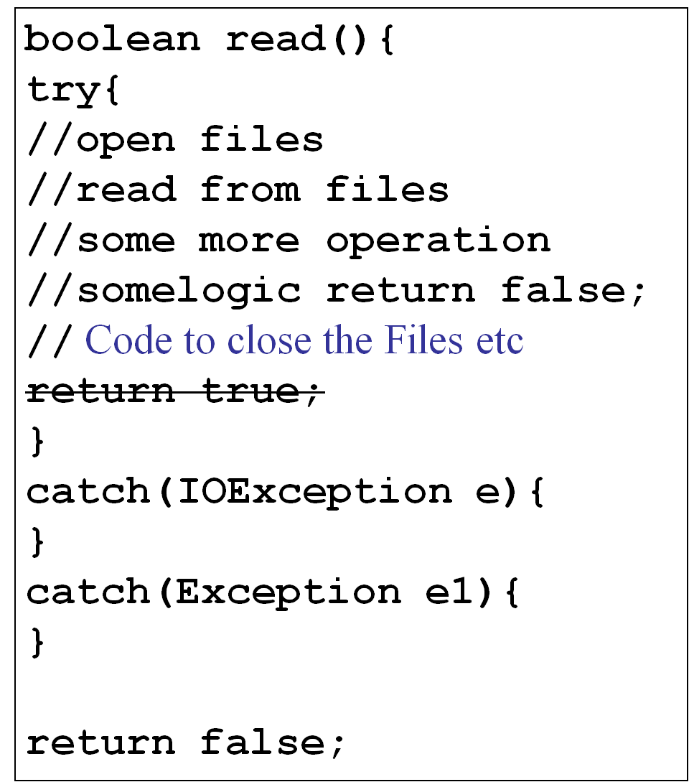
Solution
Not Working
Move
If there is a return statement somewhere in try-catch block (or exception handler) then we end up with the same problem again!

Slide 26
Java’s solution -finally
Code enclose within a finally block will always be executed (whether or not an exception occurs).
finally is a part of try-catch syntax
  try{…}
  catch(ExceptionType1 e){ …}
  [catch(ExceptionType2 e){ …}]
  finally { ... }
Finally executes even if there is a return statement in the try block.

Slide 27
boolean read(){
try{
//open a file
//read from file
return true;
}
catch(IOException e){}
catch(Exception e1){}
finally{
//close files etc
}
return false;
Will always execute

Slide 28
Exercise
Write a java code that will accept two command line arguments as numbers and print the product of two numbers.
Catch all possible exceptions and exit gracefully.
The program must display “Thank You!” before exiting.
To convert String to int use the following method of Integer class:
  public static int parseInt(String s) throws NumberFormatException

Slide 29
Few points on syntax
A try block must have either a catch block or a finally block.
For an unchecked exception the code given below compiles.
class Test{
public static void main(String s[]){
try{
throw new RuntimeException(); } finally{ System.out.println("ok"); }} }

Slide 30
class Test{
public static void main(String s[])throws Exception{
try{throw new Exception(); } finally{System.out.println("ok"); }
} }

Slide 31
User-defined exceptions
package general;
public class InvalidNameException extends Exception {
String exStr;
public InvalidNameException(){
exStr= "invalid name";
}
public InvalidNameException(String s){exStr=s;}
public String toString(){ return "InvalidNameException" + exStr;}
}

Slide 32
public abstract class Person{
public void setName(String name) throws InvalidNameException {
if(name==null)
throw new InvalidNameException();
else this.name=name; }}
…
}

Slide 33
Overriding and Exception
An overridden method cannot throw new checked exceptions or parent class exception
class Student{
public Object clone()
{
try{
return super.clone();
}catch(CloneNotSupportedException e)
{ return null;}
}
}
throws Exception
Compilation Error
No error

Slide 34

Assertions
private static int binarySearch(int numbers[], int key ){
int low,high;
int div=numbers.length;
low=0;
high=numbers.length-1;
while(true){
div=(low+high)/2;
if(low>high)
System.out.println(“div”+div);
if(key>numbers[div])
low=div+1;
else if (key<numbers[div])
high=div-1;
else
return div;
if(low> high) return -1;
}
Oops! I forgot to remove the code I added for debugging. Now what to do… code is already shipped!

Slide 35
assert
Syntax : 2 forms
assert (condition);
assert(condition): statement returning a string;
If the condition is false, the code will throw an AssertionError at run time if run with assertion enabled

Slide 36
Assertion enabling
To enable assertion at runtime :
java -ea classname or
java -enableassertions classname
private static int binarySearch(int numbers[], int key ){
int low,high;
int div=numbers.length;
low=0;
high=numbers.length-1;
while(true){
div=(low+high)/2;
assert(low<=high):"div:"+div;
if(key>numbers[div])
low=div+1;
else if (key<numbers[div])
high=div-1;
else
return div;
if(low> high) return -1; }

